Slide 1

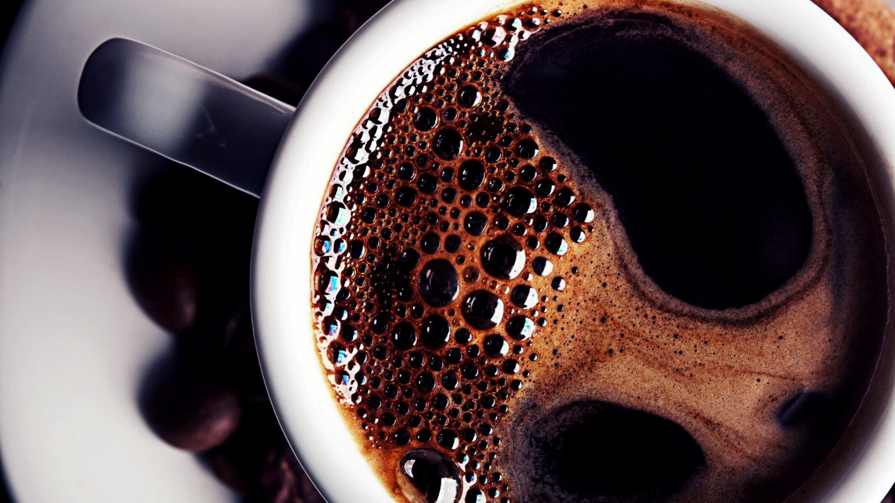
Mega M-Mart

Slide 2
Description
Mega M-Mart is an online grocery store application in which the user will be able to make selection of the products that he or she wants to buy.
01
The mobile application also has some background music. The items selected in the app will be taken to the cart and then for the billing in an account billing page that will be a separate activity.
02
The person will be able to get Pick-Up or Home Delivery facility from the store.
03

Slide 3
Why Mega M-Mart?
Mega M-Mart is an online application based on a conceptual wholesale market where a person owns the whole store and gives it people who want rent some part of the whole store. This people who wants to own some part of the store are the ones who do not have enough capital to own the whole store and wants to take less risk in starting their own business. So, what they do is own a small part such as pharmacy section or bakery section of the wholesale market.

Slide 4
Features of Mega M-Mart
This application changes working hours everyday using Calendar class, i.e, the application will check the day in user’s device and set the working hours on the description for that day.
This application provides user to add or remove items from the cart.
This application shows establishment of layout in both portrait and landscape screen-orientation.
This application adds all the selected items from the cart and provides the user with the total amount that also includes tax and delivery fee if home delivery is selected.
This application does not proceed with order until all the payment information is filled by the user. It will show an error message if any information is not filled properly.

Slide 5
Features of Mega M-Mart
If the user selects home delivery then the user have to fill some extra fields that include home address, city, province, and postal code.
The field for cvv is limited to 3-digits as it can be maximum upto 3-digits
All the fields in billing page accept correct values, i.e , for card number, it will just accept numbers and no string.
After placement of order, the completion of order message is shown on a separate activity.
The application runs a music in background till the user uses this application. The application also has the launcher icon of its name Mega M-Mart.

Slide 6
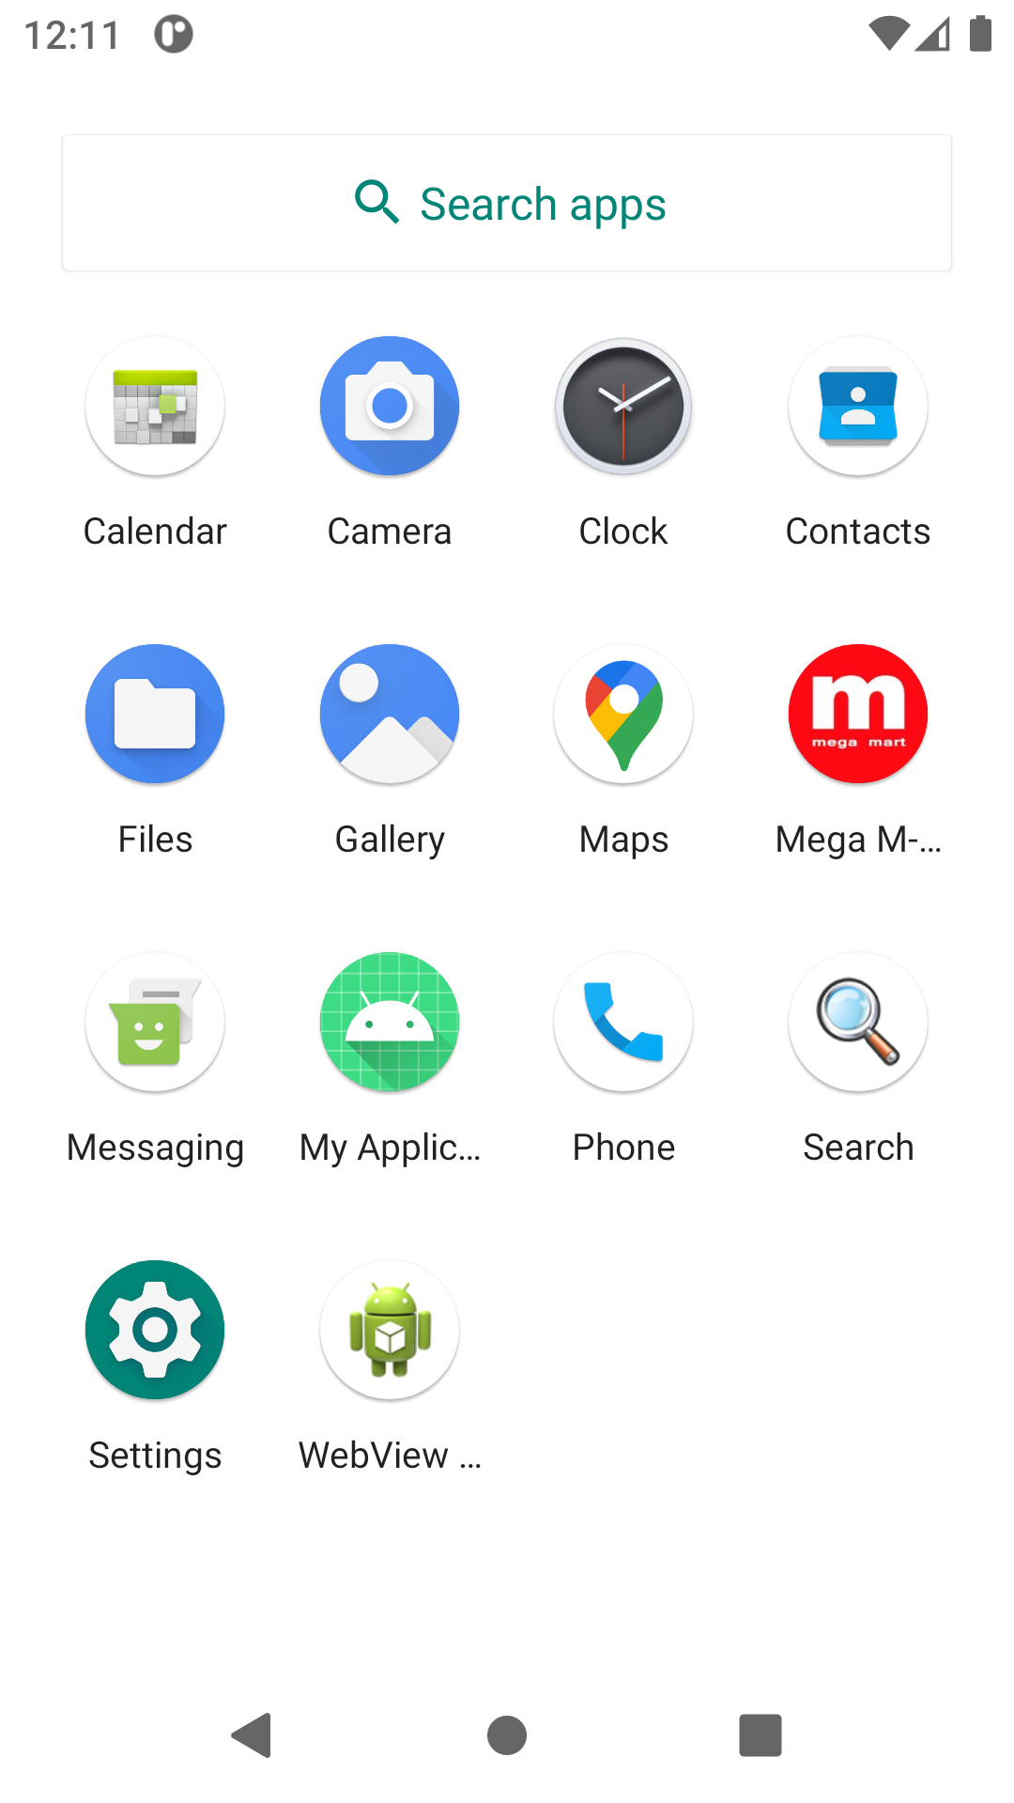
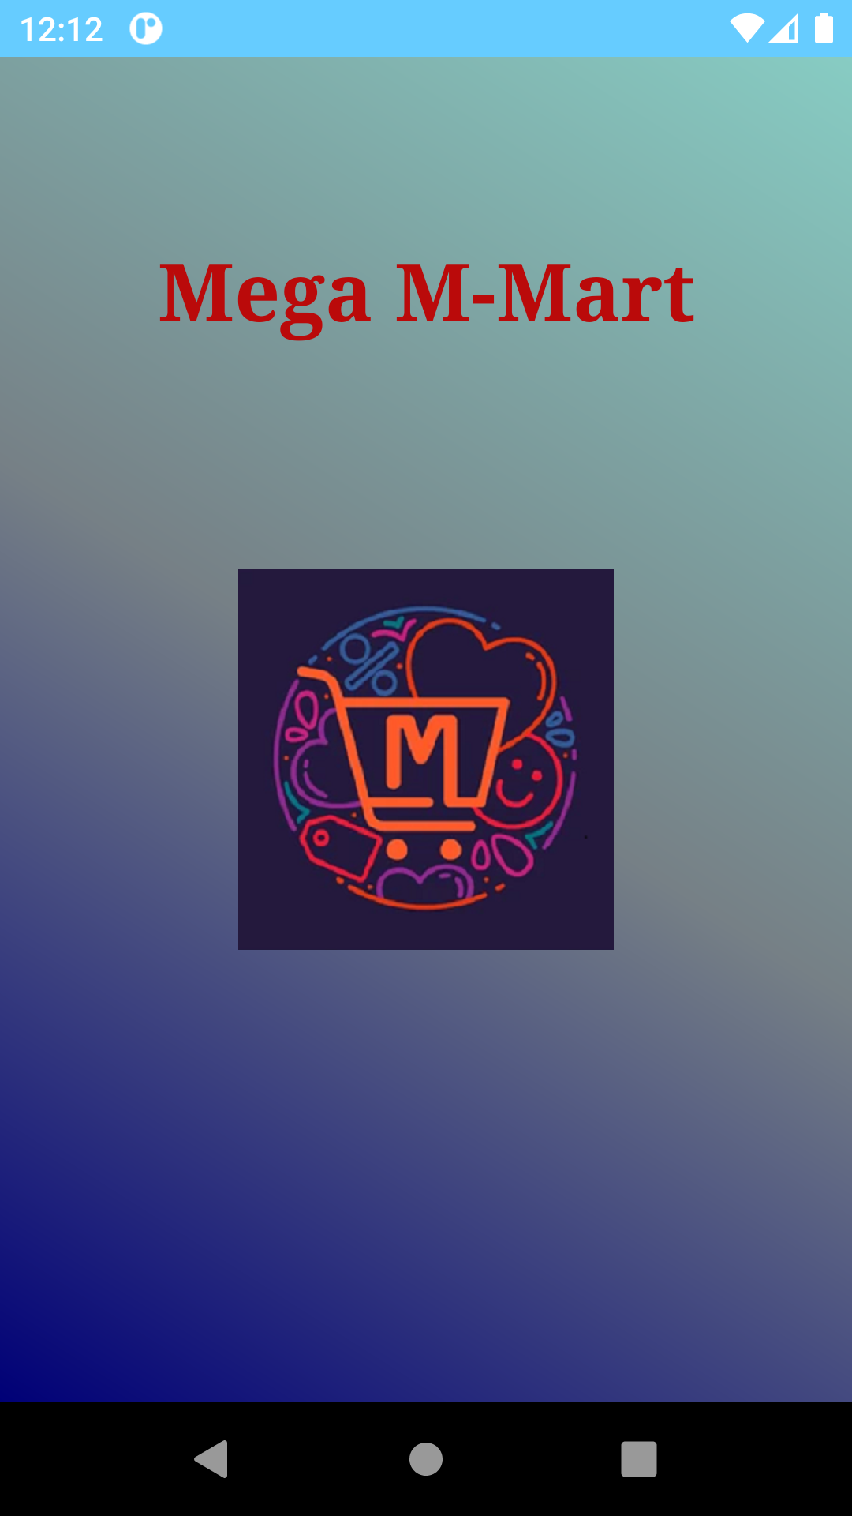
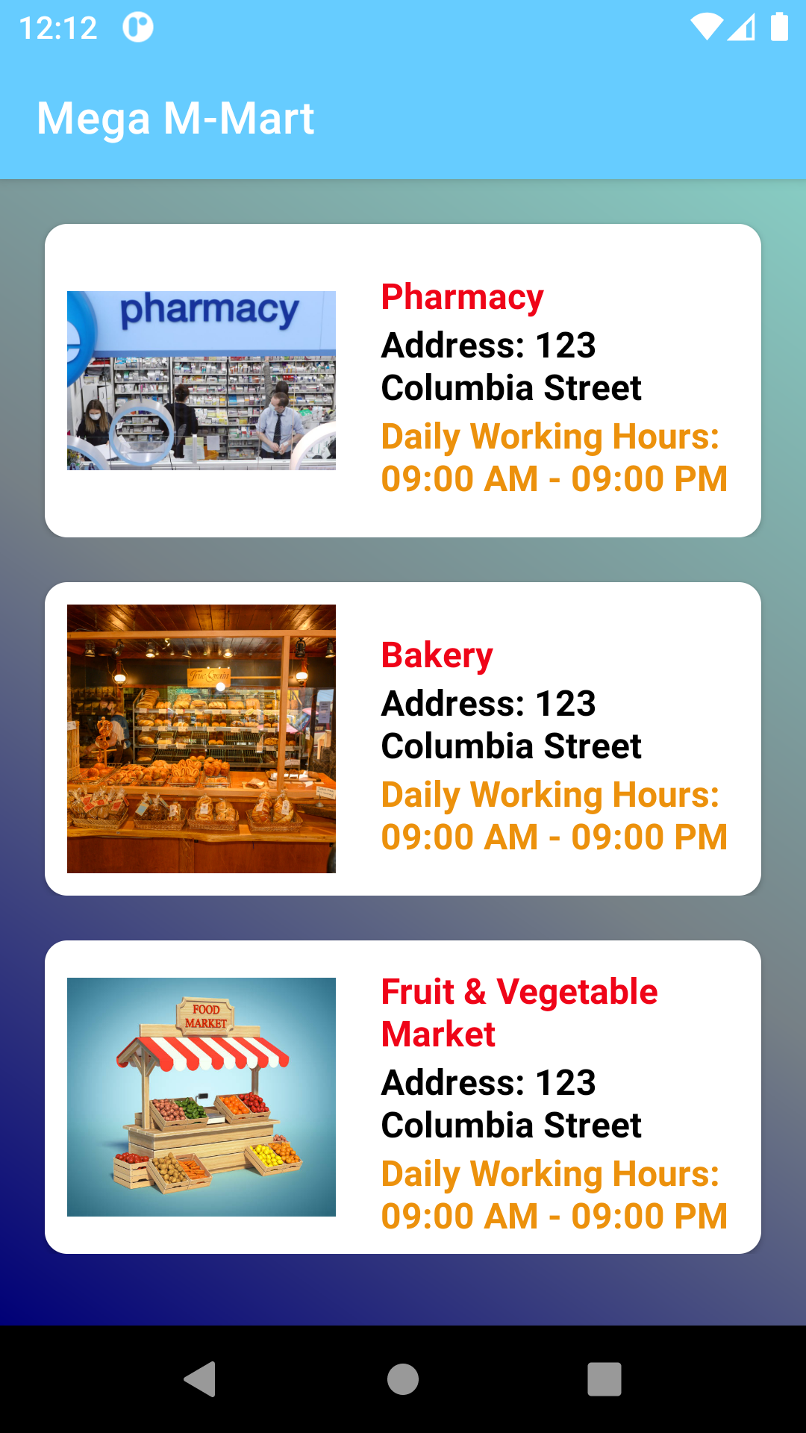
Some Output Capture of the Application

Slide 7
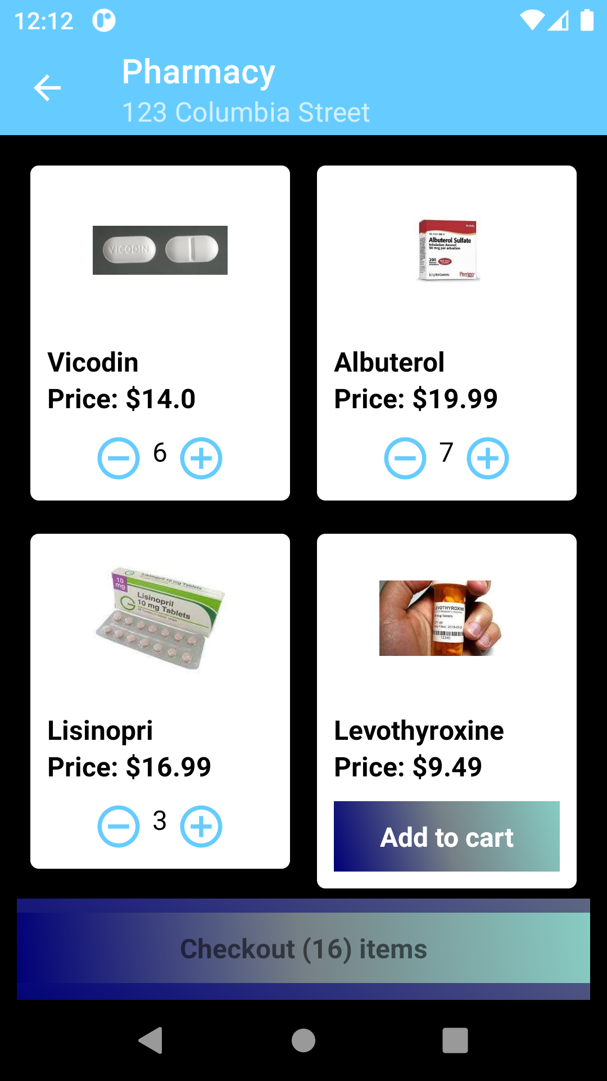
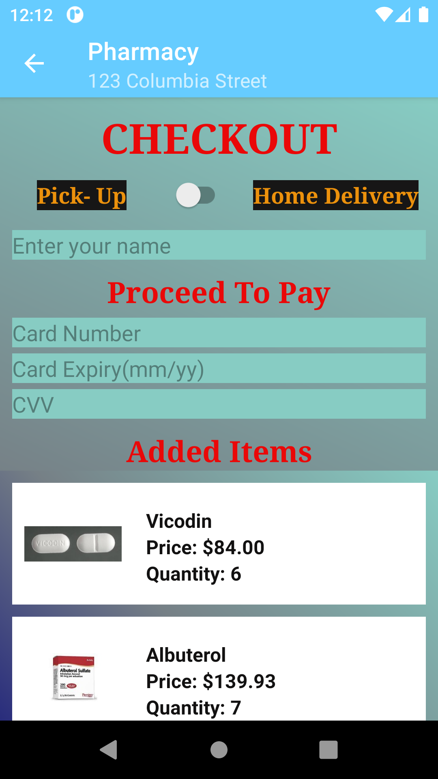
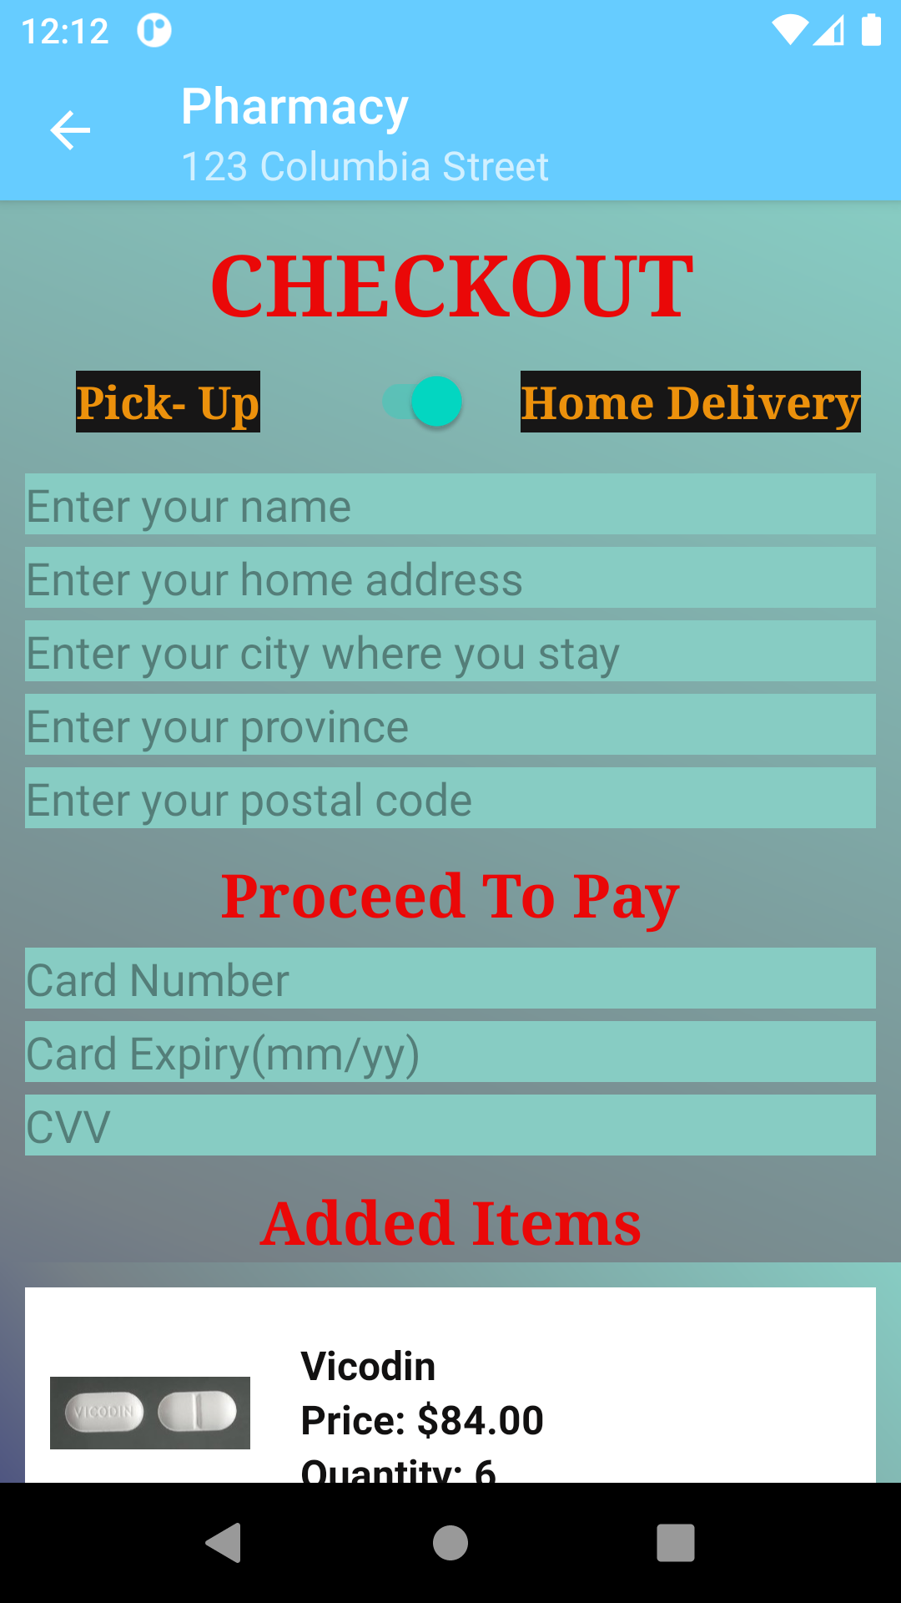
Some Output Capture of the Application

Slide 8
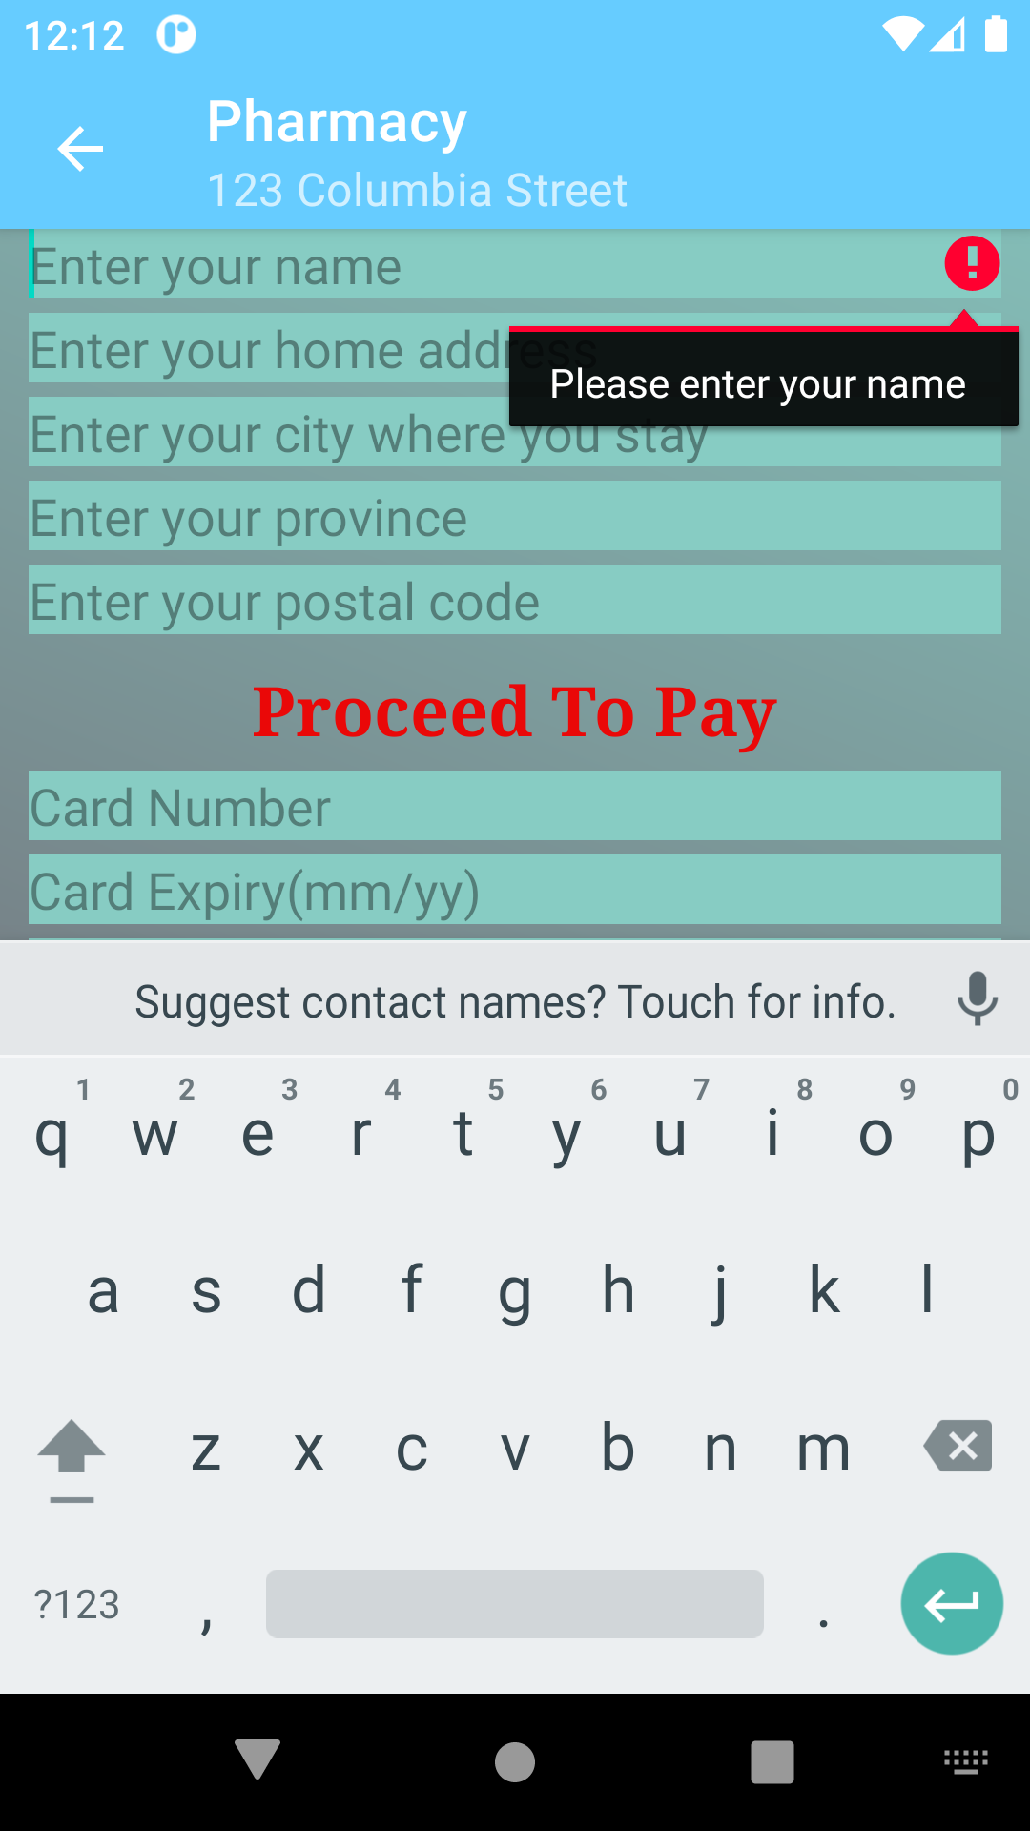
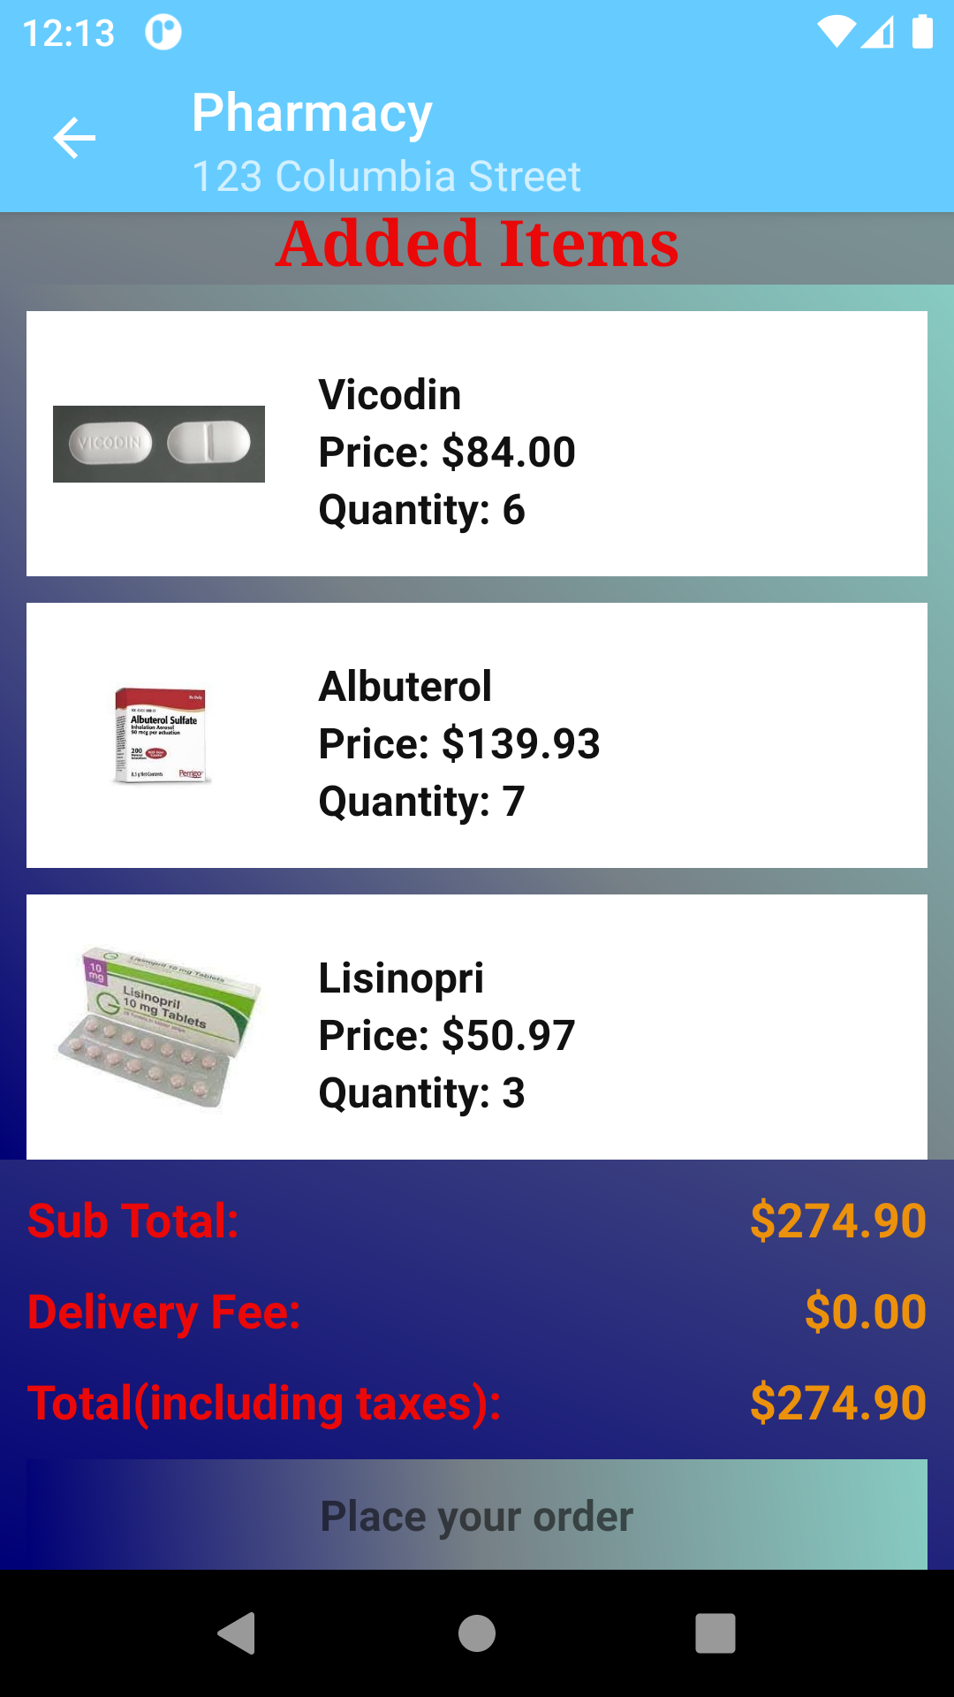
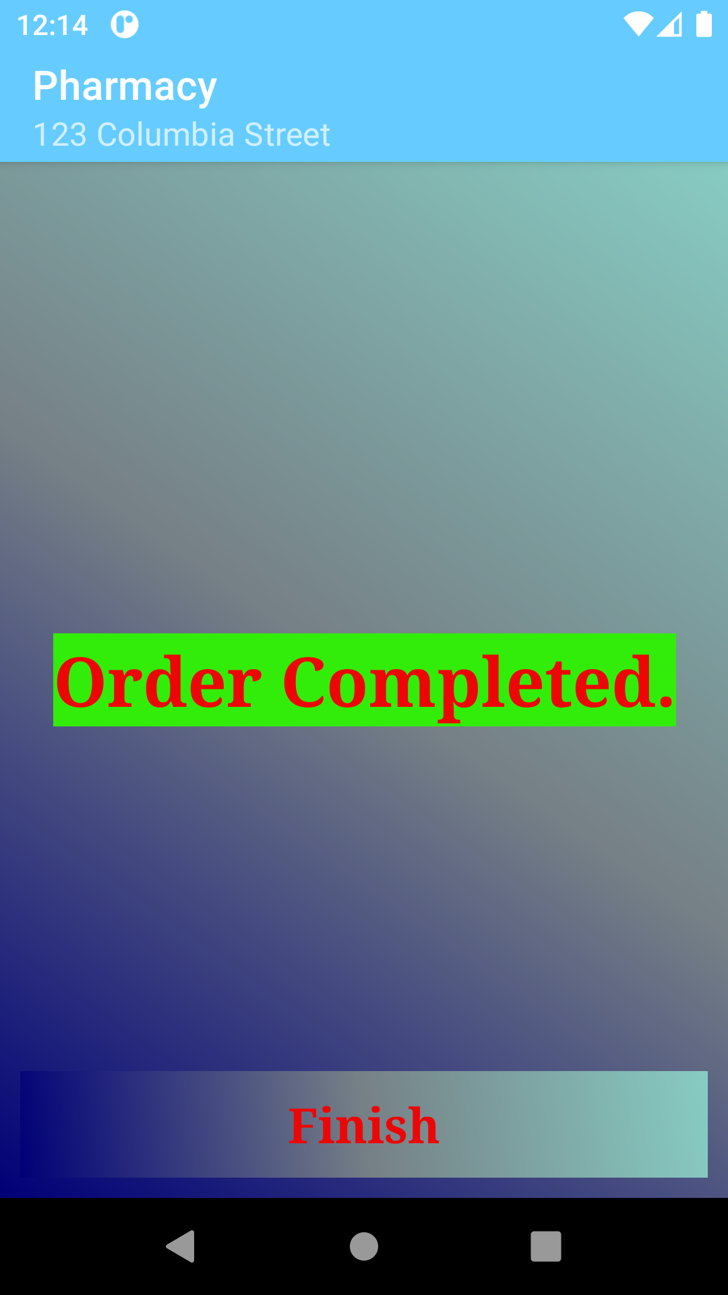
Some Output Capture of the Application

Slide 9
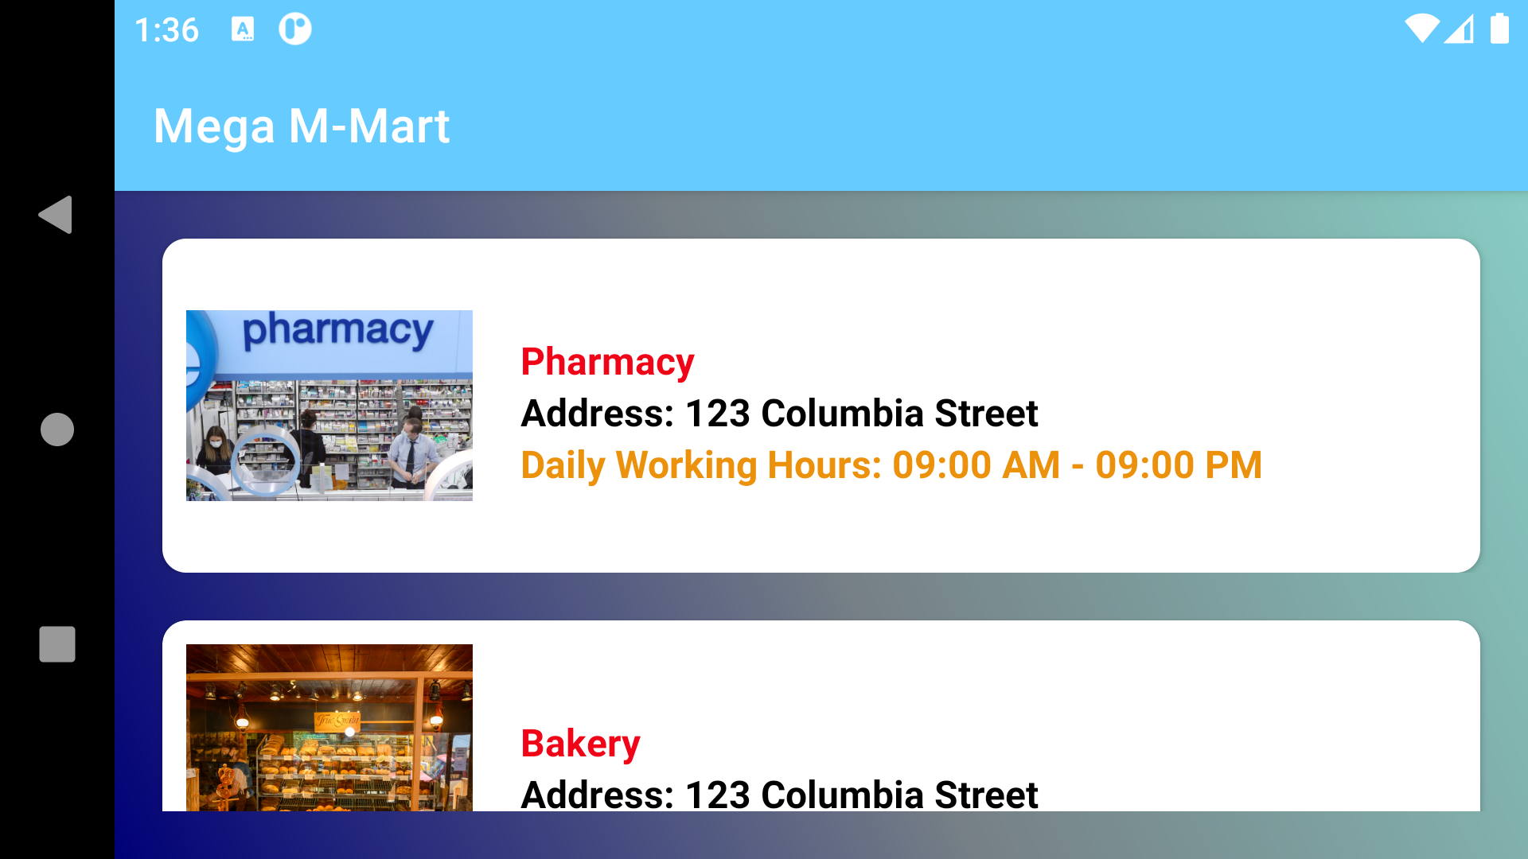
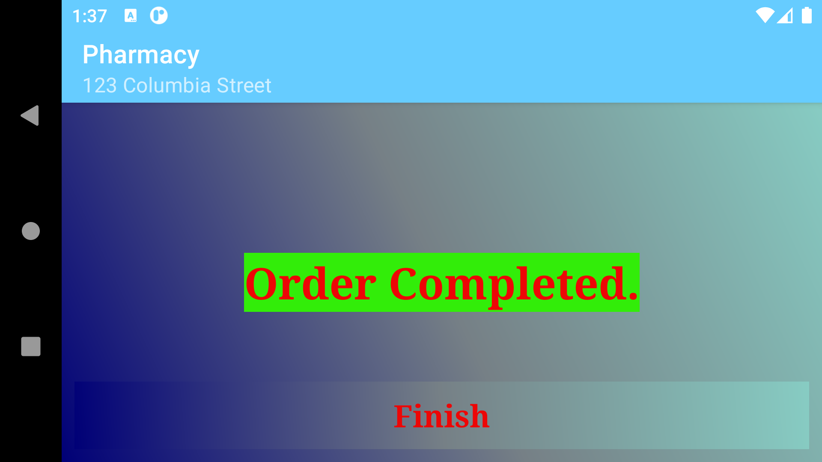
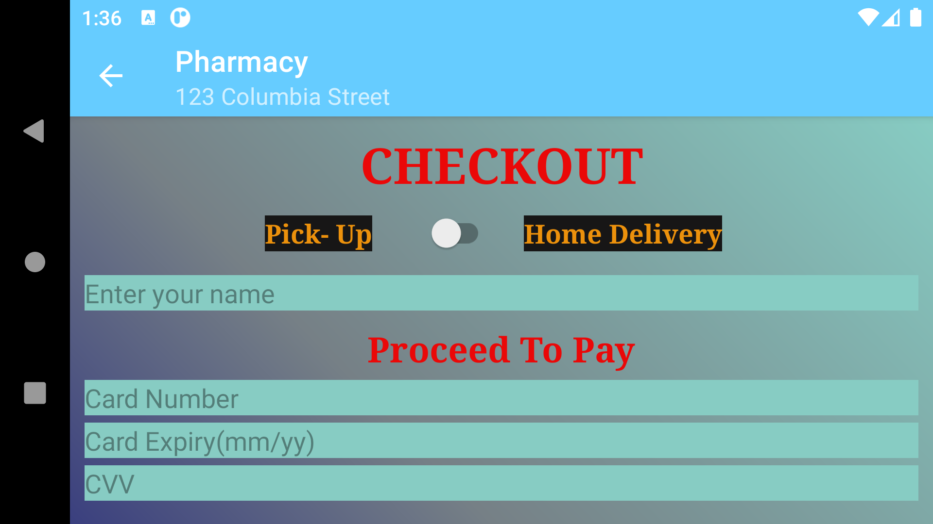
Some Output Capture of the Application

Slide 10
References
Unsplash. (n.d.). Beautiful Free Images & Pictures | Unsplash. https://unsplash.com/
(n.d.). Google. https://www.google.com
(n.d.). YouTube. https://www.youtube.com/watch?v=S4BQ9z7QijA
(n.d.). YouTube. https://www.youtube.com/watch?v=SLTUBf5FaCA
(n.d.). YouTube. https://www.youtube.com/watch?v=CnSXx07UZGs
(n.d.). YouTube. https://www.youtube.com/watch?v=DOkPTN6X2AY
(n.d.). YouTube. https://www.youtube.com/watch?v=9nFGR8dIu_w

Slide 11
Thank You

